Slide 1
Time varying causal relationships between various features during the spread of COVID-19
Arunim Bhattacharya and Sachit Butail

Slide 2
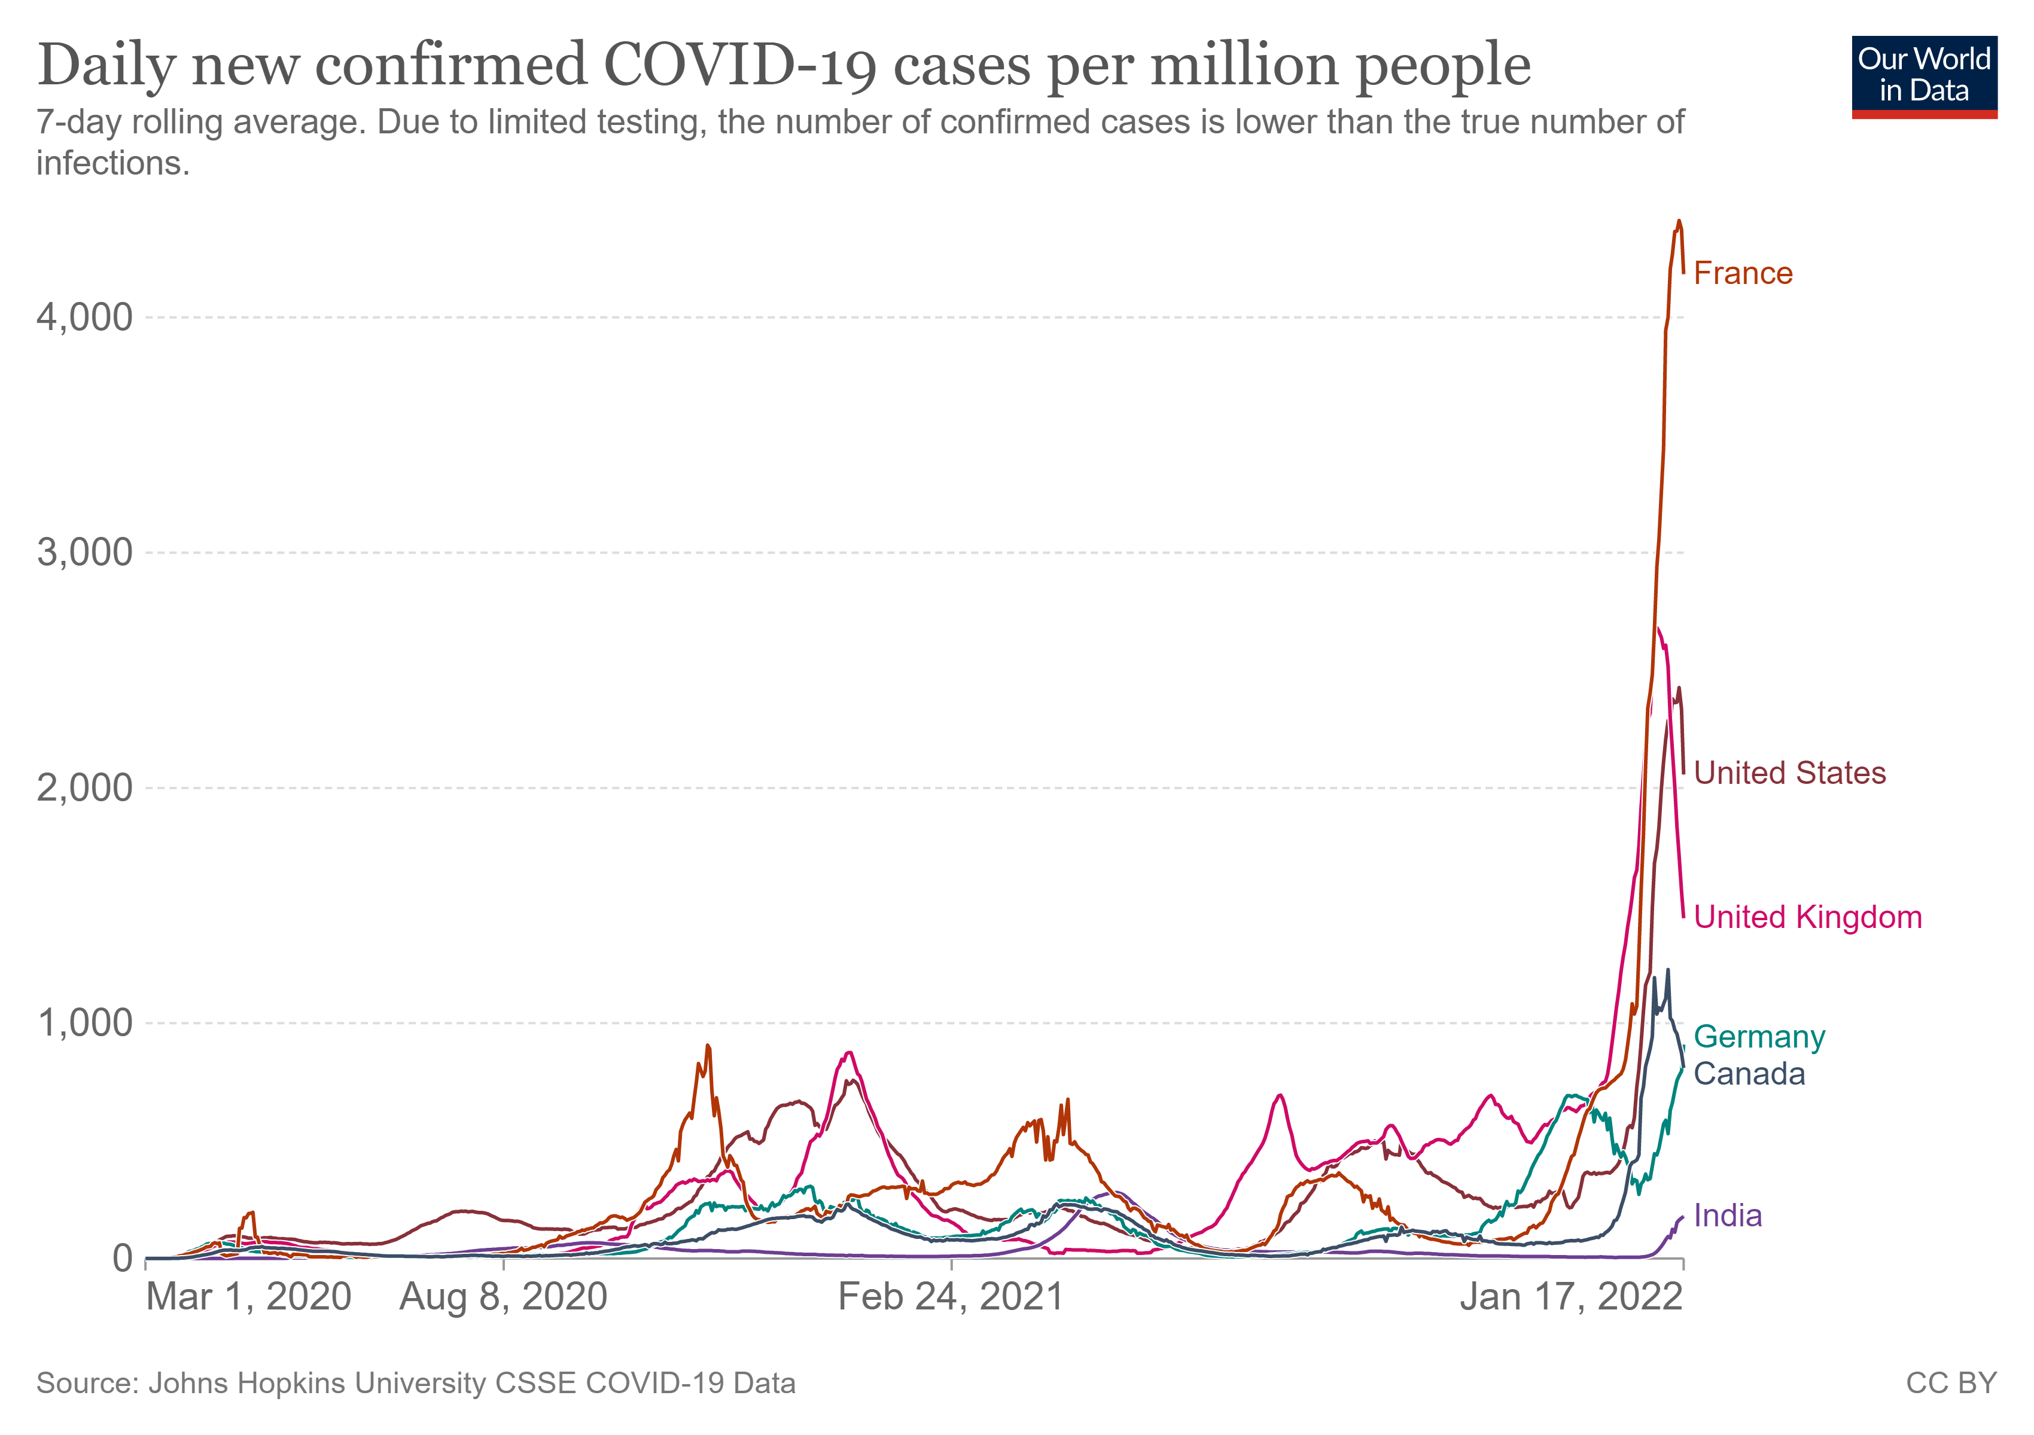
Motivation
Covid 19 is characterized by waves of infection. Possible reasons could include
Uncertain dynamic factors like mobility, mask use, vaccination rate, waning immunity etc. may play into the dynamic nature of the pandemic
At present there is enough public data available to causally link one or more of the factors to Covid pandemic dynamics.
Classic SEIR models are unable to predict these waves. Recent work has attributed this characteristic to social activity [Tkachenko et al., 2021].

Slide 3
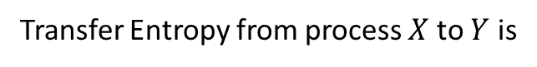
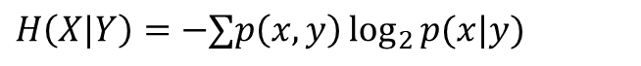
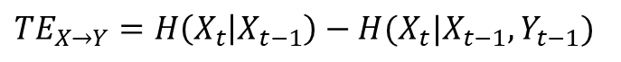
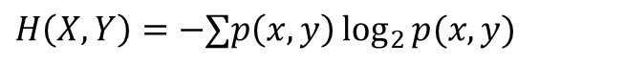
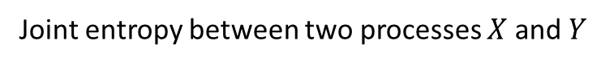
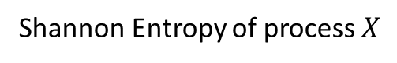
Transfer Entropy
Transfer Entropy is an information theoretic measure which quantifies the amount of information transferred between two random processes. This measure is non symmetric, thus providing a method of determining directionality of information transfer between two processes. This study assumes that the random processes are 1st order Markov chain.
Shannon Entropy of process $X$
$H\left(X\right)=−∑p\left(x\right)\log_{2}{p(x)}$, where $p\left(x\right)$ is the probability of $X$ taking the value $x$
Joint entropy between two processes $X$ and $Y$
$$H\left(X,Y\right)=−∑p\left(x,y\right)\log_{2}{p(x,y)}$$
Conditional entropy
$$H\left(X|Y\right)=−∑p\left(x,y\right)\log_{2}{p(x|y)}$$
Transfer Entropy from process $X$ to $Y$ is
$$TE_{X→Y}=H\left(X_{t} | X_{t−1}\right)−H(X_{t}|X_{t−1},Y_{t−1})$$

Slide 4
Transfer Entropy for inferring causality
Transfer Entropy (TE) will be used to determine the leading cause of infection.
To validate the approach, TE will be implemented on a coupled dynamics model, ex: Lotka Volterra and SEIR with changes
The chosen epidemic model will be modified to incorporate the dynamic factors.
A time varying causal relationship will be established by artificially modifying the dynamic factors and observing the induced change in the epidemic model output.
Next this approach will be applied to real time series data of
Infection
Death
Mobility
Testing efficacy
Mask
Other methods for inferring causality are Convergent Cross Mapping (CCM)[Sugihara et al., 2012] and using Intrinsic Mode Functions (IMF) [Yang et al., 2018]
H. Ye, E. R. Deyle, L. J. Gilarranz, and G. Sugihara, “Distinguishing time-delayed causal interactions using convergent cross mapping,” Sci Rep, vol. 5, no. 1, p. 14750, Dec. 2015, doi: 10.1038/srep14750.
A. C. Yang, C.-K. Peng, and N. E. Huang, “Causal decomposition in the mutual causation system,” Nat Commun, vol. 9, no. 1, p. 3378, Dec. 2018, doi: 10.1038/s41467-018-05845-7.

Slide 5
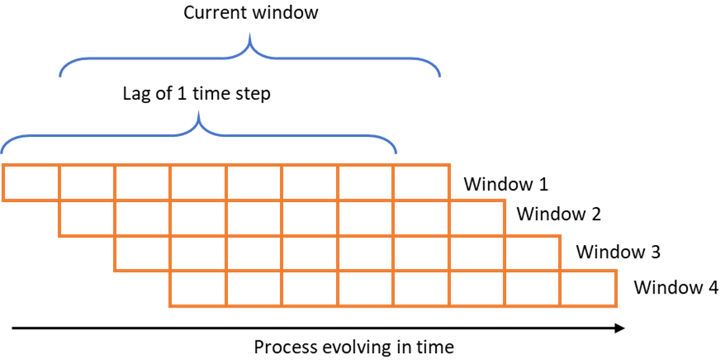
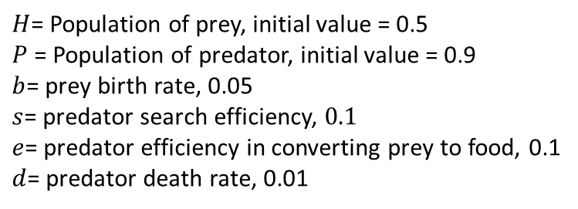
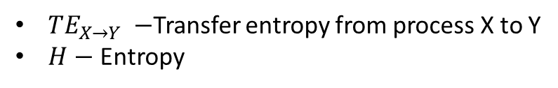
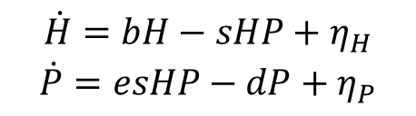
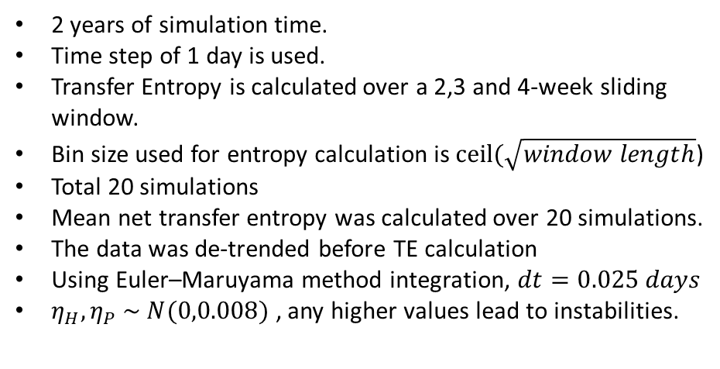
TE application to Lotka Volterra
Model
$$\dot{H}=bH−sHP+η_{H}$$
$$\dot{P}=esHP−dP+η_{P}$$
$$TE_{X→Y}=H\left(X_{t} | X_{t−1}\right)−H(X_{t}|X_{t−1},Y_{t−1})$$
$TE_{X→Y} −$Transfer entropy from process X to Y
$H−$ Entropy
2 years of simulation time.
Time step of 1 day is used.
Transfer Entropy is calculated over a 2,3 and 4-week sliding window.
Bin size used for entropy calculation is $ceil(\sqrt{window length}$)
Total 20 simulations
Mean net transfer entropy was calculated over 20 simulations.
The data was de-trended before TE calculation
Using Euler–Maruyama method integration, $dt=0.025 days$
$η_{H},η_{P} \sim N(0,0.008)$ , any higher values lead to instabilities.
$H$= Population of prey, initial value = 0.5
$P$ = Population of predator, initial value = 0.9
$b$= prey birth rate, 0.05
$s$= predator search efficiency, $0.1$
$e$= predator efficiency in converting prey to food, 0.1
$d$= predator death rate, 0.01
Transfer Entropy Sliding Window

Slide 6
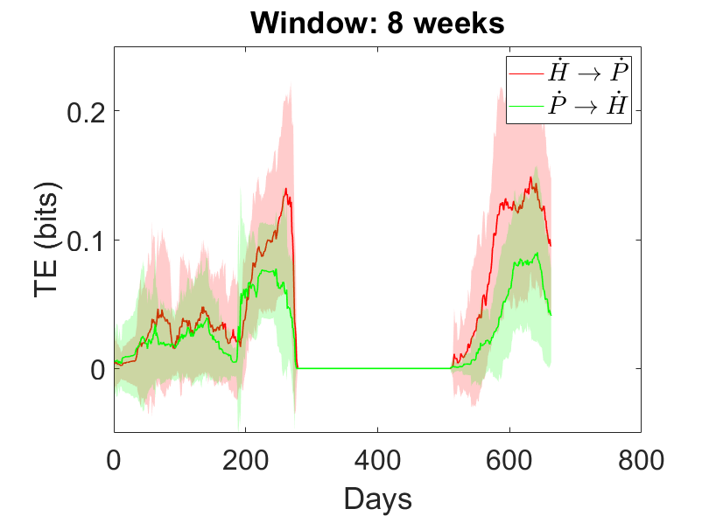
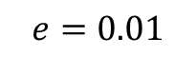
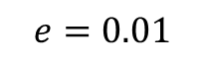
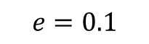
LV TE Normalized by Square root of entropies
$$e=0.01$$
$$e=0.01$$
$$e=0.1$$

Slide 7
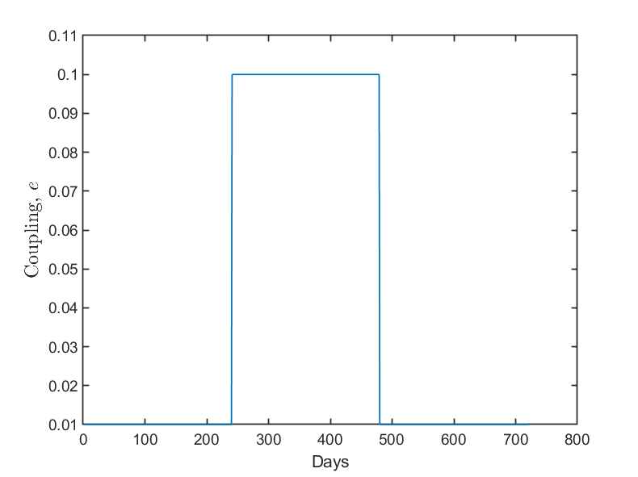
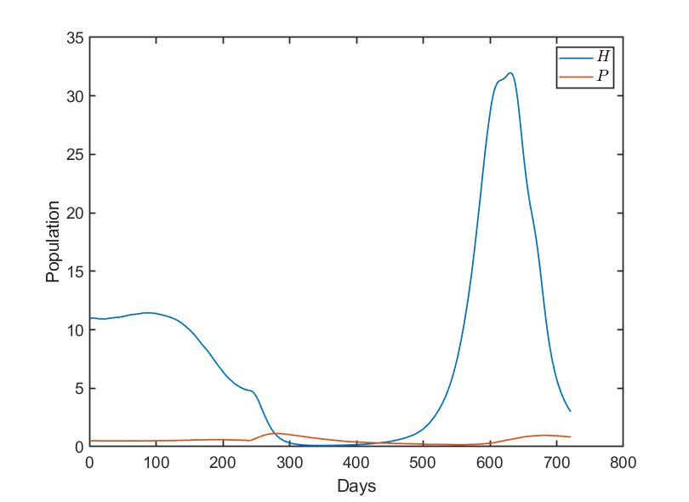
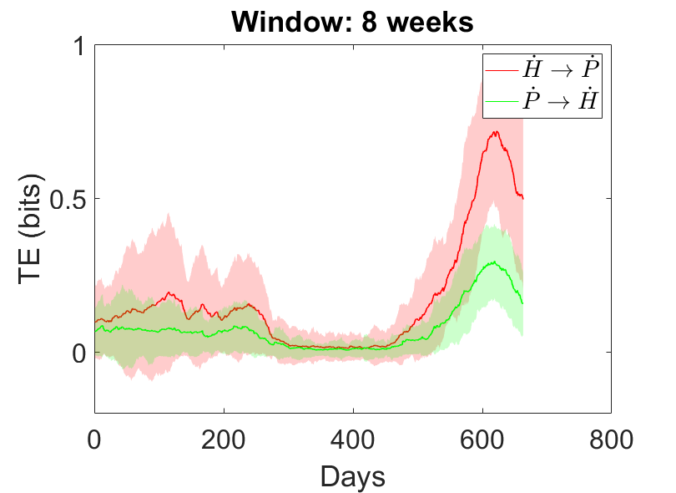
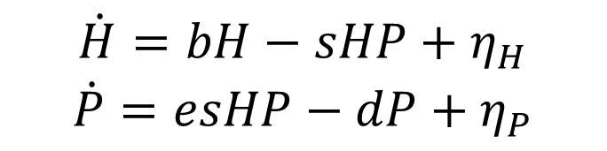
Switching Coupling parameter in Lotka Volterra
$$\dot{H}=bH−sHP+η_{H}$$
$$\dot{P}=esHP−dP+η_{P}$$

Slide 8
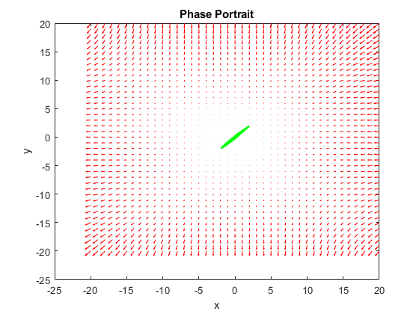
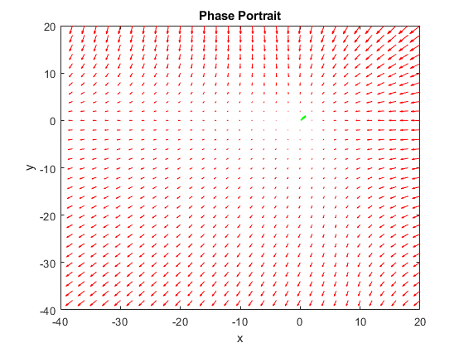
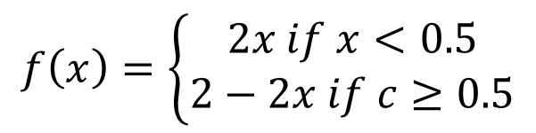
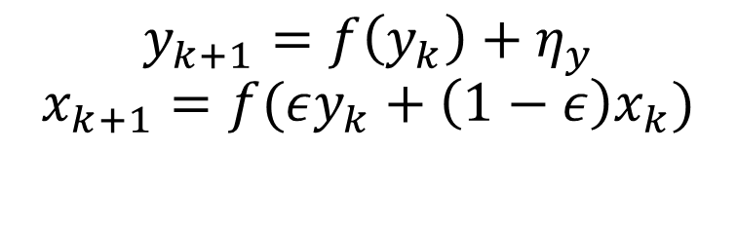
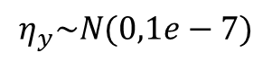
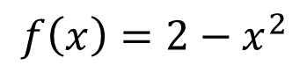
Unidirectional coupling (Tent and Ulam)
$$y_{k+1}=f\left(y_{k}\right)+η_{y}$$
$$x_{k+1}=f(εy_{k}+\left(1−ε\right)x_{k})$$
$$η_{y}\sim N(0,1e−7)$$
Tent Map
$$f\left(x\right)=\left\{\begin{aligned}2x if x<0.5 \\ 2−2x if c≥0.5\end{aligned}\right.$$
Ulam Map Phase Portrait
Tent Map Phase Portrait
Ulam Map
$$f\left(x\right)=2−x^{2}$$

Slide 9
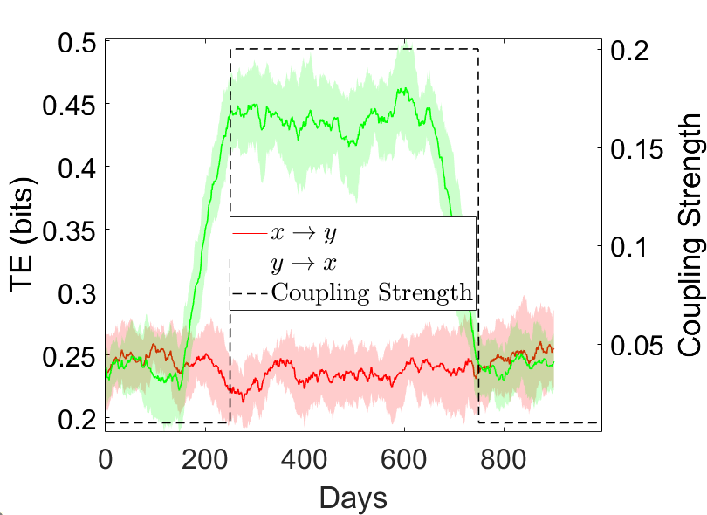
TE Tent map normalized square root of entropies and switching coupling parameter

Slide 10
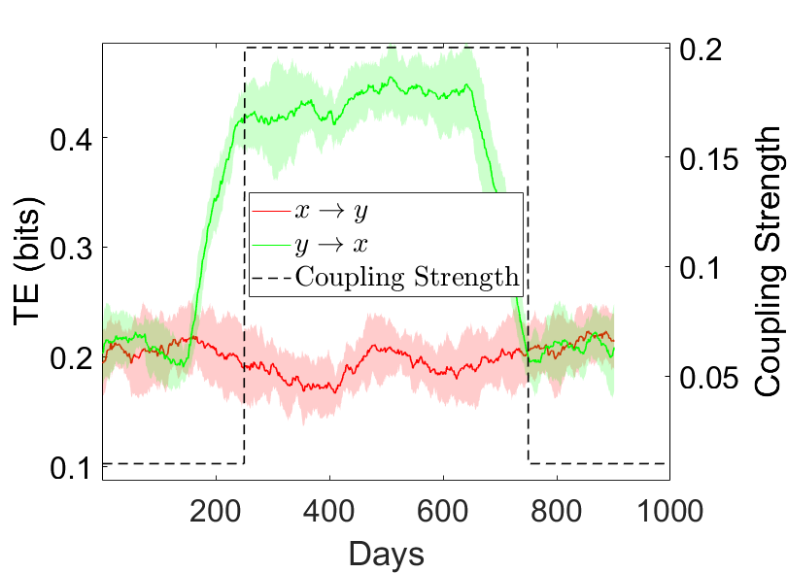
TE Ulam map normalized square root of entropies and switching coupling parameter

Slide 11
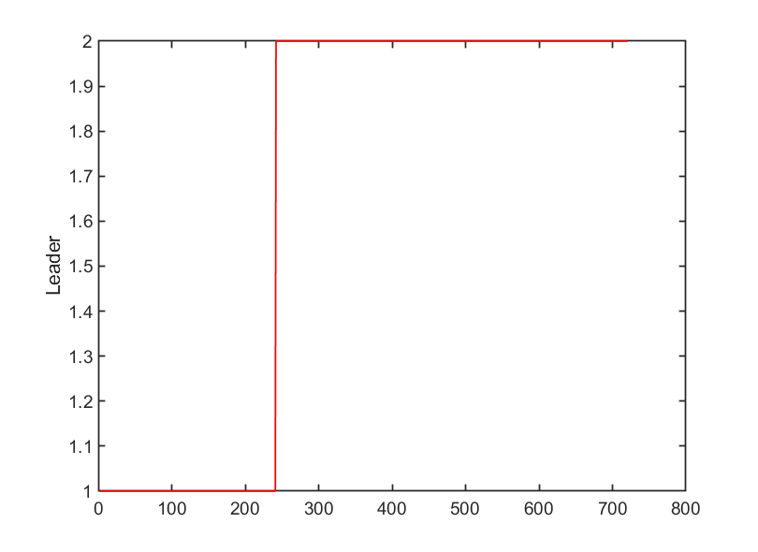
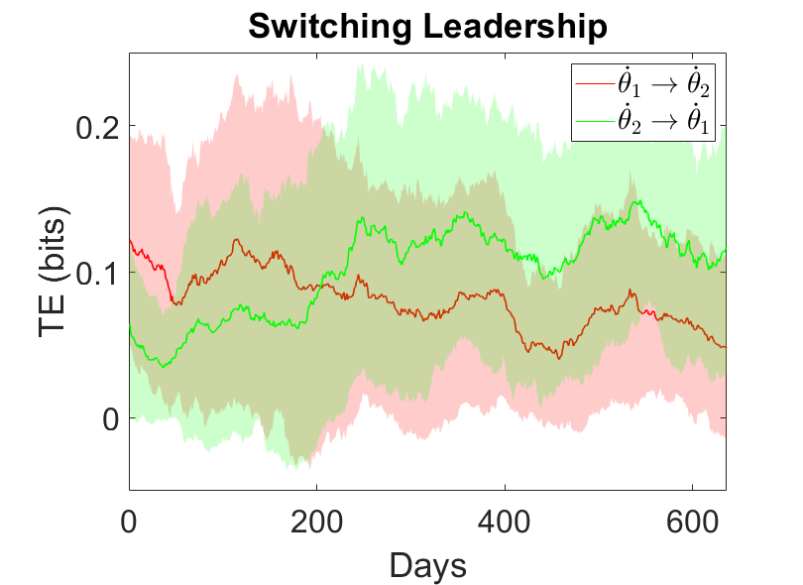
Vicsek Two Particle model with switching

Slide 12
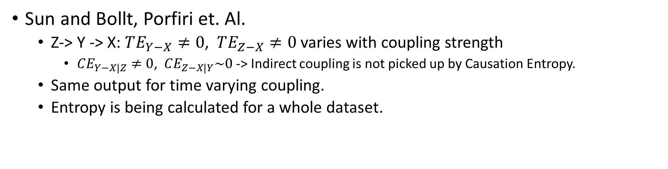
Causation Entropy/ Conditional TE
For multiple random processes, some are indirectly coupled and others are directly coupled. Transfer Entropy does not to discriminate between these direct and indirect couplings. Conditional Transfer Entropy however avoids picking up the indirectly coupled processes. For multi-way coupled models like SEIS, it is useful to obtain conditional TE to identify the processes that are directly coupled.
Sun and Bollt, Porfiri et. Al.
Z-> Y -> X: $TE_{Y−X}≠0$, $TE_{Z−X}≠0$ varies with coupling strength
$CE_{Y−X|Z}≠0$, $CE_{Z−X|Y}\sim 0$ -> Indirect coupling is not picked up by Causation Entropy.
Same output for time varying coupling.
Entropy is being calculated for a whole dataset.
J. Sun and E. M. Bollt, “Causation Entropy Identifies Indirect Influences, Dominance of Neighbors and Anticipatory Couplings,” Physica D: Nonlinear Phenomena, vol. 267, pp. 49–57, Jan. 2014, doi: 10.1016/j.physd.2013.07.001.
M. Porfiri, R. R. Sattanapalle, S. Nakayama, J. Macinko, and R. Sipahi, “Media coverage and firearm acquisition in the aftermath of a mass shooting,” Nat Hum Behav, vol. 3, no. 9, pp. 913–921, Sep. 2019, doi: 10.1038/s41562-019-0636-0.

Slide 13
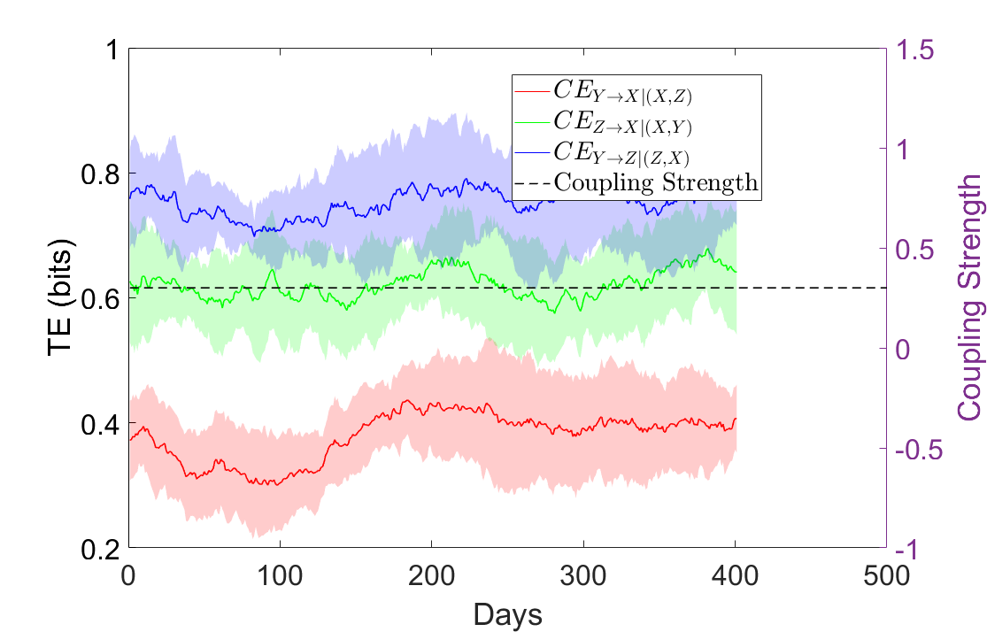
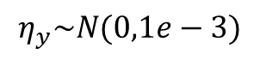
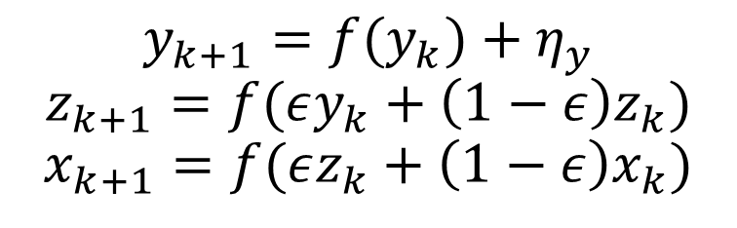
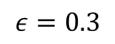
Causation Entropy Tent map
$$y_{k+1}=f(y_{k})+η_{y}$$
$$z_{k+1}=f(εy_{k}+\left(1−ε\right)z_{k})$$
$$x_{k+1}=f(εz_{k}+\left(1−ε\right)x_{k})$$
$$η_{y}\sim N(0,1e−3)$$
$$ε=0.3$$
Y -> Z -> X

Slide 14
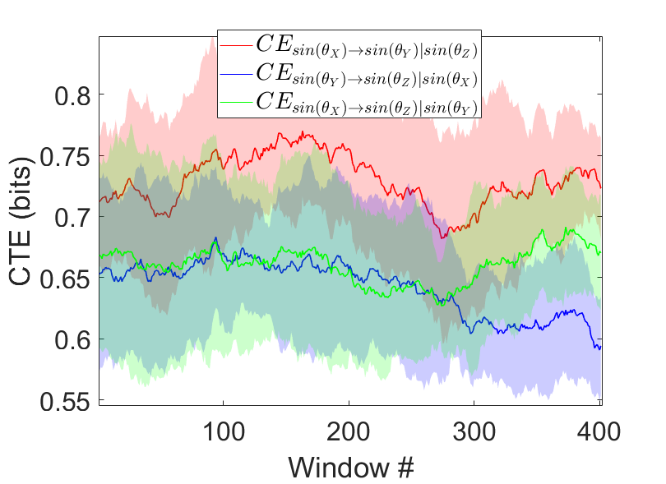
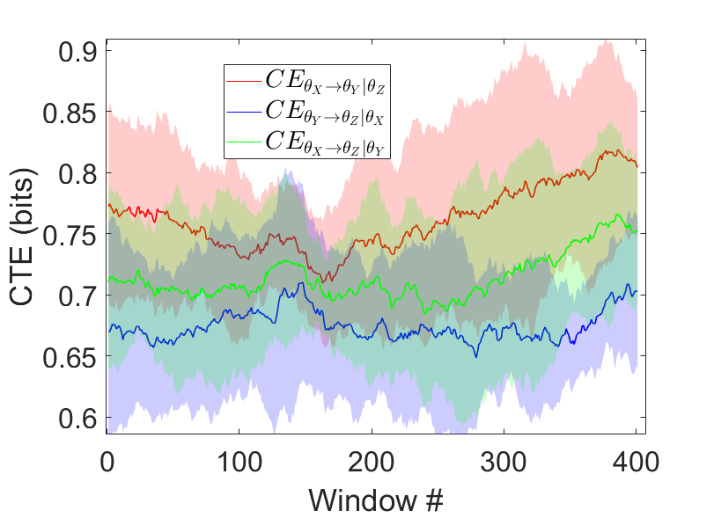
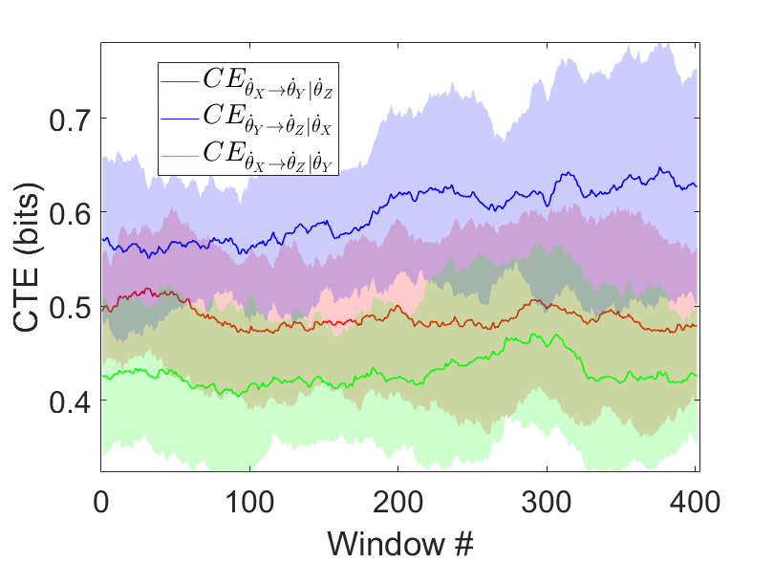
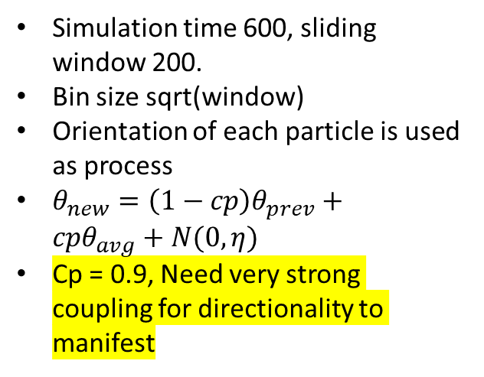
Vicsek’s Model with agent hierarchy
Three particles: X, Y, Z
X is independent.
X->Y->Z
Simulation time 600, sliding window 200.
Bin size sqrt(window)
Orientation of each particle is used as process
$θ_{new}=\left(1−cp\right)θ_{prev}+cpθ_{avg}+N(0,η)$
Cp = 0.9, Need very strong coupling for directionality to manifest

Slide 15
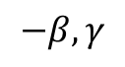
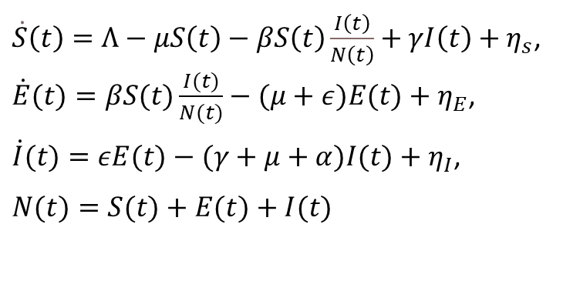
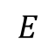
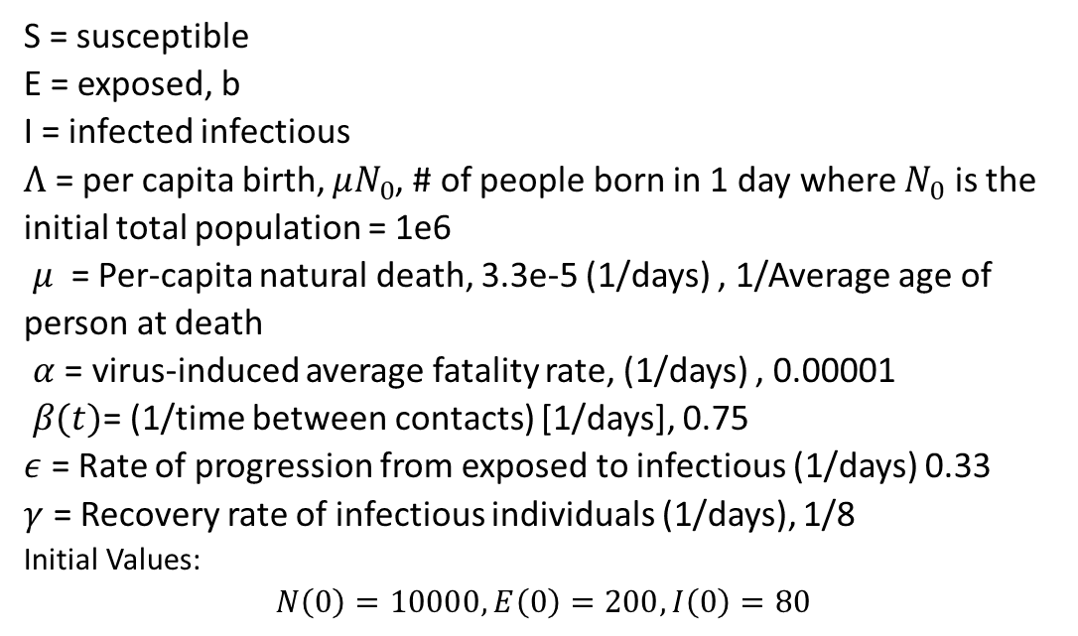
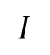
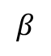
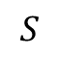
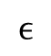
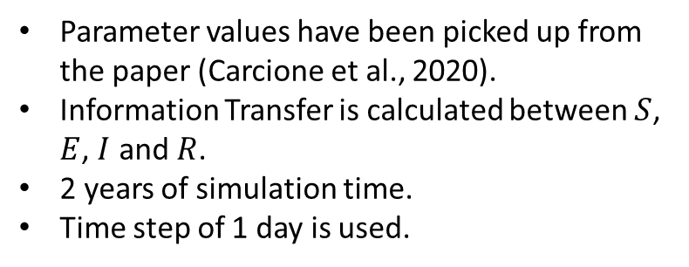
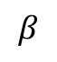
SEIS Model
$$−β,γ$$
$$S$$
$\dot{S}\left(t\right)=Λ−μS\left(t\right)−βS\left(t\right)\frac{I\left(t\right)}{N\left(t\right)}+γI\left(t\right)+η_{s}$, $\dot{E}(t)=βS(t)\frac{I(t)}{N(t)}−(μ+ε)E(t)+η_{E}$,
$\dot{I}(t)=εE(t)−(γ+μ+α)I(t)+η_{I}$,
$$N(t)=S(t)+E(t)+I(t)$$
$$I$$
$$β$$
$$ϵ$$
S = susceptible
E = exposed, b
I = infected infectious
$Λ$ = per capita birth, $μN_{0}$, # of people born in 1 day where $N_{0}$ is the initial total population = 1e6
$μ$ = Per-capita natural death, 3.3e-5 (1/days) , 1/Average age of person at death
$α$ = virus-induced average fatality rate, (1/days) , 0.00001
$β(t)$= (1/time between contacts) [1/days], 0.75
$ε$ = Rate of progression from exposed to infectious (1/days) 0.33
$γ$ = Recovery rate of infectious individuals (1/days), 1/8
Initial Values: $$N\left(0\right)=10000, E\left(0\right)=200,I\left(0\right)=80$$
$$β$$
$$E$$
Parameter values have been picked up from the paper (Carcione et al., 2020).
Information Transfer is calculated between $S$, $E$, $I$ and $R$.
2 years of simulation time.
Time step of 1 day is used.

Slide 16
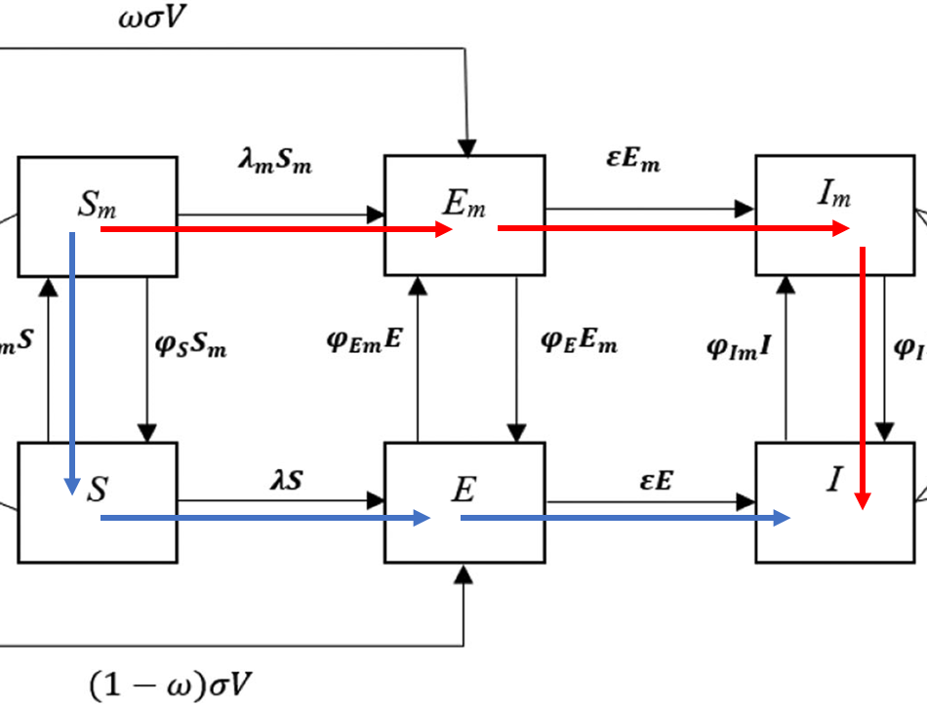

Methods
Why not use mask, vaccination, mobility, infection and mortality data directly to compute TE or CTE?
TE will only identify causal links b/w the data
It doesn’t tell us the mechanism
It represents only one experiment, but TE needs more data.
TE b/w Mask, Vaccinated, Mobility to Infected on real data will indicate relative link strengths.
An existing SEIR* model will be modified to include mask, vaccination and isolation compartments. It will be fitted to the real data, that will enable extraction of hidden variables like S, E, and R.
The mechanics of infection can be identified by using conditional TE (CTE):
Most effective paths leading to infection can be found by comparing CTEs of different paths.
Looking at $S_{m} →I$, the figure notes 2 paths b/w the start and end points. $TE_{S_{m}→I}$ will tell us the causality b/w the two parameters. $CTE_{S_{m}→I|E_{m}}$ will tell us the influence $S_{m}$ will have on $I$ disregarding influence of $E_{m} →I$, thus if $CTE_{S_{m}→I|E_{m}}<CTE_{S_{m}→I|S}$ which would mean the blue line carries less influence than red line.
*Maged, Ahmed, et al. "SEIR Model to address the impact of face masks amid COVID‐19 pandemic." Risk Analysis (2022).

Slide 17
Use of Real data

Slide 18

Raw smoothed Data (USA) using healthdata model

Slide 19

SEIR model with vaccination*
Fit parameters
*Maged, Ahmed, et al. "SEIR Model to address the impact of face masks amid COVID‐19 pandemic." Risk Analysis (2022).

Slide 20

Author results

Slide 21

Reproduced results

Slide 22
Methods
Update Maged’s model to include mobility
Fit the new model to real data
Use parameters fr

Slide 23














































$$κ_{r_{h}}R$$
$$S_{h}$$
$$λ_{h}S_{h}$$
$$E_{h}$$
$$εE_{h}$$
$$I_{h}$$
$$σ_{Sh}U$$
$$ξ_{S}S_{h}$$
$$ξ_{E}E_{h}$$
$$μI_{h}$$
$$ξ_{E_{h}}E$$
$$ξ_{I_{h}}I$$
$$ξ_{I}I_{h}$$
$$ξ_{S_{h}}S$$
$$κ_{R}R$$
$$αS_{h}$$
$$γI_{h}$$
$$σ_{S}U$$
$$λS$$
$$εE$$
$$U$$
$$S$$
$$E$$
$$I$$
$$μI$$
$$αS$$
$$D$$
$$γI$$
$$φ_{S}S_{m}$$
$$φ_{S_{m}}S$$
$$φ_{E}E_{m}$$
$$φ_{E_{m}}E$$
$$φ_{I}I_{m}$$
$$φ_{I_{m}}I$$
$$σ_{S_{m}}U$$
$$αS_{m}$$
$$R$$
$$μI_{m}$$
$$S_{m}$$
$$E_{m}$$
$$I_{m}$$
$$γI_{m}$$
$$λ_{m}S_{m}$$
$$εE_{m}$$
$$\dot{V}=α(S_{m}+S_{h}+S)$$
$$κ_{R_{m}}R$$

Slide 24













































$$κR$$
c
$$λ_{h}S_{h}$$
$$εE_{h}$$
$$S_{h}$$
$$E_{h}$$
$$I_{h}$$
$$σU$$
$${ξ_{1}S}_{h}$$
$$ξ_{1}E_{h}$$
$$μI_{h}$$
$$ξ_{2}E$$
$$ξ_{2}I$$
$$ξ_{1}I_{h}$$
$$ξ_{2}S$$
$$κR$$
$$αS_{h}$$
$$γI_{h}$$
$$σU$$
$$λS$$
$$εE$$
$$S$$
$$E$$
$$I$$
$$U$$
a
$$μI$$
$$αS$$
$$D$$
$$γI$$
$$φ_{2}S_{m}$$
$$φ_{1}S$$
$$φ_{2}E_{m}$$
$$φ_{1}E$$
$$φ_{2}I_{m}$$
$$φ_{1}I$$
$$σU$$
$$αS_{m}$$
$$R$$
$$μI_{m}$$
b
$$S_{m}$$
$$E_{m}$$
$$I_{m}$$
$$γI_{m}$$
$$λ_{m}S_{m}$$
$$εE_{m}$$
$$κR$$

Slide 25

Parameter values from paper
Parameters
$η_{s}$= Decrease in susceptibility b/c of mask, 0.35 | $β$ = Transmissibility, 0.312 | $I$ = not masked, infectious
$η_{i}$= Decrease in infectivity b/c of mask, 0.45 | $α$ = Vaccination rate, 0.001 | $I_{m}$ = masked, infectious
$σ$ = vaccine inefficiency, 0.001 | $λ$ = Conversion rate from $S →E$ | $V$ = Vaccinated
$ε$ = progression to Infectious class, 0.22 | $λ_{m}$ = Conversion rate from $S_{m}→E_{m}$ | $R$ = Recovered
$ω$ = ratio of vaccinated individuals wearing masks, 0.005 | $S$ = not masked, susceptible | $D$ = Dead
$γ$= Recovery rate, 0.0602 | $S_{m}$ = masked, susceptible | $φ_{X}$= Conversion rate from masked to not masked within a class
$μ$ = Mortality, 0.0035 | $E$ = not masked, exposed | $φ_{Xm}$ = Conversion rate from not masked to masked within a class
$τ$ = threshold after which people start wearing masks, 100 | $E_{m}$= masked, exposed | $ω_{R}$ = rate of recovered to susceptible population wearing masks b/c of new virus strains
 |  | $κ$ = rate of conversion of recovered population to susceptible class

Slide 26










- Tune able Parameters
Switch so that \xi_s, \xi_E is \xi_2 and so on…

Slide 27


Slide 28













Objective function
$$O=w_{D}\sqrt{\sum_{t}{{\left(\hat{D\left(t\right)}−D\left(t\right)\right)}^{2}}}+w_{I}\sqrt{\sum_{t}{{\left(\hat{I\left(t\right)}−I\left(t\right)\right)}^{2}}}{+ w}_{U}\sqrt{\sum_{t}{{\left(\hat{V\left(t\right)}−V(t)\right)}^{2}}}{+ w}_{H}\sqrt{\sum_{t}{{\left(\hat{H\left(t\right)}−H\left(t\right)\right)}^{2}}}{+ w}_{M}\sqrt{\sum_{t}{{\left(\hat{M\left(t\right)}−M\left(t\right)\right)}^{2}}}$$
$$V\left(t\right)= \sum_{τ=0}^{t}{U(t)}$$
$$w_{D}=0.35, w_{I}=0.1, w_{U}=0.35, w_{H}=0.1,w_{M}=0.1$$
$$H={−(S}_{h}+E_{h}+I_{h})/(S_{h}+E_{h}+I_{h}+S_{m}+E_{m}+I_{m}+S+E+I+U+D +R)$$
$$M={(S}_{m}+E_{m}+I_{m})/(S_{h}+E_{h}+I_{h}+S_{m}+E_{m}+I_{m}+S+E+I+U+D +R)$$
Initial Conditions
$$S_{0}=9.7E6 −24$$
$$I_{0}=24$$
Other parameters start from 0
$$0.1≤φ_{1},φ_{2},ξ_{1},ξ_{2}≤1$$
$$0.01≤σ_{S}, σ_{S_{m}}, σ_{S_{h}},κ_{R_{h}},κ_{R},κ_{R_{m}}≤1$$
$$0.2≤β≤0.4$$
$$0.01≤γ≤0.3$$
$$0.001≤μ≤0.01$$
$$0.1≤η_{s_{m}}≤1.0$$
$$0.1≤η_{I_{m}}≤1.0$$
$$0.1≤ε≤1.0$$
$$0.1≤η_{S_{h}}≤1.0$$
$$0.1≤η_{I_{h}}≤1.0$$

Slide 29

UKF variable estimations

Slide 30

UKF parameter estimations

Slide 31

UKF SEI individual compartments

Slide 32

SEI mean plots with standard deviation

Slide 33

TEs on different infection routes

Slide 34


Slide 36
Appendix

Slide 37


Slide 38


Slide 39


Slide 40



Parameters within limits as described in previous slides
$$Initial$$
$$Δ$$
omicron

Slide 41


Slide 42


Slide 43


Slide 44





- Tune able Parameters

Slide 45






Objective function
$$O=w_{D}\sqrt{\sum_{t}{{\left(\hat{D\left(t\right)}−D\left(t\right)\right)}^{2}}}+w_{I}\sqrt{\sum_{t}{{\left(\hat{I\left(t\right)}−I\left(t\right)\right)}^{2}}}{+ w}_{U}\sqrt{\sum_{t}{{\left(\hat{V\left(t\right)}−V(t)\right)}^{2}}}{+ w}_{H}\sqrt{\sum_{t}{{\left(\hat{H\left(t\right)}−H\left(t\right)\right)}^{2}}}{+ w}_{M}\sqrt{\sum_{t}{{\left(\hat{M\left(t\right)}−M\left(t\right)\right)}^{2}}}$$
$$V\left(t\right)= \sum_{τ=0}^{t}{U(t)}$$
$$w_{D}=0.35, w_{I}=0.1, w_{U}=0.35, w_{H}=0.1,w_{M}=0.1$$
$$H={−(S}_{h}+E_{h}+I_{h})/(S_{h}+E_{h}+I_{h}+S_{m}+E_{m}+I_{m}+S+E+I+U+D +R)$$
$$M={(S}_{m}+E_{m}+I_{m})/(S_{h}+E_{h}+I_{h}+S_{m}+E_{m}+I_{m}+S+E+I+U+D +R)$$
Initial Conditions
$$S_{0}=9.7E6 −24$$
$$I_{0}=24$$
Other parameters start from 0
$$0.01≤ ω_{1}, ω_{2}, θ_{1}, θ_{2},ζ_{1}, ζ_{2}, a_{1},a_{2},b_{1},b_{2}≤10$$
$$0.01≤σ_{S_{max}}, σ_{{S_{m}}_{max}}, σ_{S_{h_{max}}}, c, η_{i}≤1$$
$$300≤t_{0}≤1000$$
$$0.2≤β≤0.4$$
$$0.01≤γ≤0.3$$
$$0.001≤μ≤0.01$$
$$0.01≤η_{s_{m}}≤1.0$$
$$0.01≤η_{I_{m}}≤1.0$$
$$0.1≤ε≤0.3$$
$$0.01≤η_{S_{h}}≤1.0$$
$$0.01≤η_{I_{h}}≤1.0$$

Slide 46


Slide 47

Dry-Run with new weights

Slide 48

Death Fit

Slide 49

Vaccination fit

Slide 50

Death and Vaccination Fit

Slide 51

Multiple Fit

Slide 52

Multiple Fit

Slide 53

Multiple Fit

Slide 54

Fit
Fit with 1000 days

Slide 55

Piecewise
\kappa -2
\beta -3
\mu – 3
t1 of beta 1 is same as t1 of mu1
Lower limits of t-s to new variants
Try different objective functions including max and weighted and pareto etc.

Slide 56

Multiple Fit

Slide 57

Infectious Fit

Slide 58
Appendix

Slide 59








TE
Simulation time 2 year, sliding window 8 weeks.
Bin size sqrt(window)
Process used is rate of change in S,E,I
Time shifted surrogate data.
$$−\frac{βS}{N}+γ$$
$$S$$
$$I$$
$$\frac{βI}{N}$$
$$ϵ$$
$$E$$
$$\frac{βS}{N}$$

Slide 60



TE and CTE comparison
Simulation time 2 year, sliding window 8 weeks.
Bin size sqrt(window)
Process used is rate of change in S,E,I
Time shifted surrogate data
CTE is lower than its TE counterpart.

Slide 61








Updated SEIS Model
$$V$$
$${−ρ}_{v}$$
$$−β,γ$$
$$S$$
$$ρ_{m}$$
$\dot{S}\left(t\right)=Λ−μS\left(t\right)−βS\left(t\right)\frac{I\left(t\right)}{N\left(t\right)}+γI\left(t\right)+p_{m}M\left(t\right)S−p_{v}V\left(t\right)S+η_{s}$, $\dot{E}\left(t\right)=βS\left(t\right)\frac{I\left(t\right)}{N\left(t\right)}−\left(μ+ε\right)E\left(t\right)−p_{k}K\left(t\right)E+η_{E}$,
$\dot{I}(t)=εE(t)−(γ+μ+α)I(t)+η_{I}$,
$$N(t)=S(t)+E(t)+I(t)$$
$$β$$
$$M$$
$$I$$
$$ϵ$$
S = susceptible
E = exposed, b
I = infected infectious
$Λ_{n}$= per capita birth, $μN_{0}$, # of people born in 1 day where $N_{0}$ is the initial total population = 1e6
$μ$ = Per-capita natural death, 3.3e-5 (1/days) , 1/Average age of person at death
$α$ = virus-induced average fatality rate, (1/days) , 0.00001
$β(t)$= (1/time between contacts) [1/days], 0.75
$ε$ = Rate of progression from exposed to infectious (1/days) 0.33
$γ$ = Recovery rate of infectious individuals (1/days), 1/8
M(t) = Mobility
V(t) = Vaccine effectiveness
K(t) = Mask Use
Initial Values: $$N\left(0\right)=10000, E\left(0\right)=200,I\left(0\right)=80$$
$$β$$
$$E$$
$${−ρ}_{k}$$
$$K$$
Parameter values have been picked up from the paper (Carcione et al., 2020).
Information Transfer is calculated between $S$, $E$, $I$ and $R$.
2 years of simulation time.
Time step of 1 day is used.

Slide 62















Updated SEIS Model
$\dot{S}\left(t\right)=Λ−μS\left(t\right)−\frac{β\left(S\left(t\right)−ρ_{o}O\left(t\right)−ρ_{v}V\left(t\right)\right)\left(I\left(t\right)−ρ_{k}K\left(t\right)\right)}{N\left(t\right)}+γI(t)+η_{s}$, $\dot{E}\left(t\right)=\frac{β\left(S\left(t\right)−ρ_{o}O\left(t\right)−ρ_{v}V\left(t\right)\right)\left(I\left(t\right)−ρ_{k}K\left(t\right)\right)}{N\left(t\right)}−\left(μ+ε\right)E\left(t\right)+η_{E}$,
$\dot{I}(t)=εE(t)−(γ+μ+α)I(t)+η_{I}$,
$$N\left(t\right)=S\left(t\right)+E\left(t\right)+I\left(t\right)+O\left(t\right)+V\left(t\right)+K(t)$$
$$V$$
$${−ρ}_{v}$$
$$−\frac{βS}{N}+γ$$
$$S$$
$$ρ_{m}$$
$$\frac{βI}{N}$$
$$M$$
$$I$$
$$ϵ$$
$$E$$
$${−ρ}_{k}$$
S = susceptible
E = exposed, b
I = infected infectious
$Λ$ = per capita birth, $μN_{0}$, # of people born in 1 day where $N_{0}$ is the initial total population = 1e6
$μ$ = Per-capita natural death, 3.3e-5 (1/days) , 1/Average age of person at death
$α$ = virus-induced average fatality rate, (1/days) , 0.00001
$β(t)$= (1/time between contacts) [1/days], 0.75
$ε$ = Rate of progression from exposed to infectious (1/days) 0.33
$γ$ = Recovery rate of infectious individuals (1/days), 1/8
O(t) = # Isolated
V(t) = # vaccinated
K(t) = Mask Use
Initial Values: $N\left(0\right)=10000, E\left(0\right)=200,I\left(0\right)=80$
$$\frac{βS}{N}$$
$$K$$

Slide 63











Updated SEIS Model
$$\dot{S}=λN−μS −\frac{β_{I}SI}{N}−\frac{β_{k}SK}{N}−\frac{β_{o}SO}{N}+γ_{I}I+γ_{k}K+γ_{o}O−ρ_{L}S+ρ_{R}L$$
$\dot{E}=\frac{β_{I}SI}{N}+\frac{β_{k}SK}{N}+\frac{β_{o}SO}{N}−εE−μE$
$$\dot{I}=εE−γ_{I}I−μI−αI−ρ_{k}I−ρ_{o}O$$
$$\dot{K}=ρ_{k}I−γ_{k}K$$
$$\dot{L}=ρ_{L}S−ρ_{R}L$$
$\dot{O}=ρ_{0}O−γ_{O}O$
S: Susceptible who are not isolated and not vaccinated $S_{0}$
L: Locked down, $S_{h}$
V: vaccinated
I: Infected + not wearing masks
K : Infected + wearing masks
O : Isolated
$ρ_{L}$= rate of lockdown
$ρ_{R}$ = rate of reopening
$ρ_{k}$= Mask acceptance
$ρ_{o}$ = isolation prev
$γ_{k}$= Recovery rate for infected individuals (Infected + wearing masks)
$γ_{I}$= Recovery rate (Infected + not wearing masks)
$γ_{O}=$ Conversion rate of isolated to susceptible
$$γ_{k}$$
$$ε$$
S
$$\frac{β_{I}I}{N}+\frac{β_{k}K}{N}+\frac{β_{o}O}{N}$$
E
I
$$ρ_{R}$$
$$ρ_{L}$$
$$ρ_{k}− γ_{k}$$
X
L
X
K
$$γ_{O}$$
V
$$γ_{k}$$
$$γ_{O}$$
O

Slide 64




